Slide 1

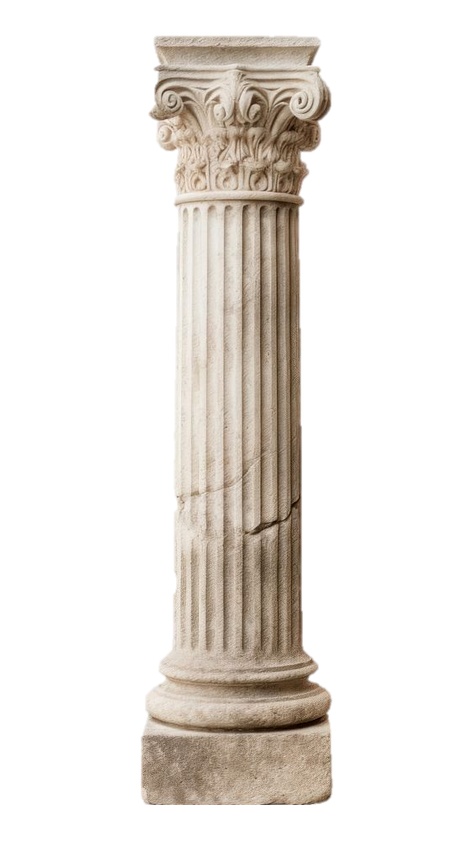
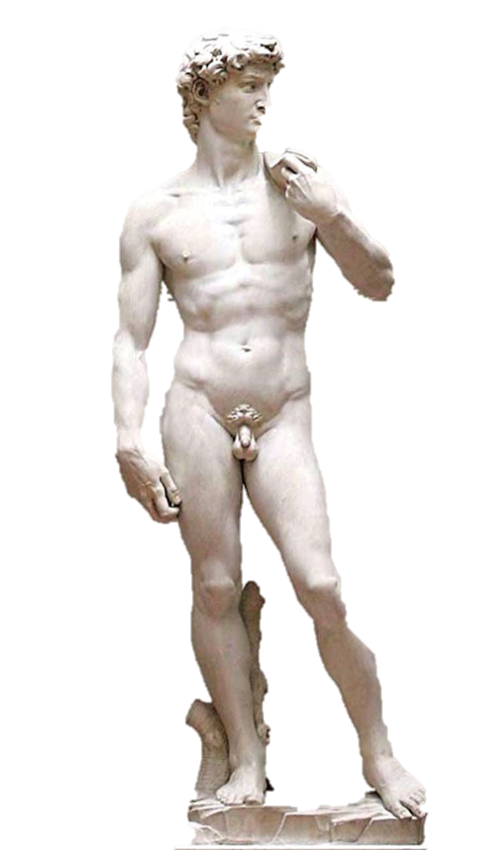
EGYPTIAN
GREEK
BYZANTINE
ROMAN
RENNAISSANCE
BAROQUE
MODERN PHILIPPINE
SCULPTURE
&
ARCHITECTURE
ARENAS, ESTRADA, GUTIERREZ, PACIS, RECAÑA

Slide 2
GREEK
BYZANTINE
ROMAN
RENNAISSANCE
BAROQUE
MODERN PHILIPPINE
EGYPTIAN
SCULPTURE
&
ARCHITECTURE
ARENAS, ESTRADA, GUTIERREZ, PACIS, RECAÑA

Slide 3
GREEK
BYZANTINE
ROMAN
RENNAISSANCE
BAROQUE
MODERN PHILIPPINE
EGYPTIAN
SCULPTURE AND ARCHITECTURE CHARACTERISTICS
SERVE RELIGION
REINFORCE ROYAL POWER
SECURE AFTERLIFE
SCULPTURE
&
ARCHITECTURE
ARENAS, ESTRADA, GUTIERREZ, PACIS, RECAÑA

Slide 4
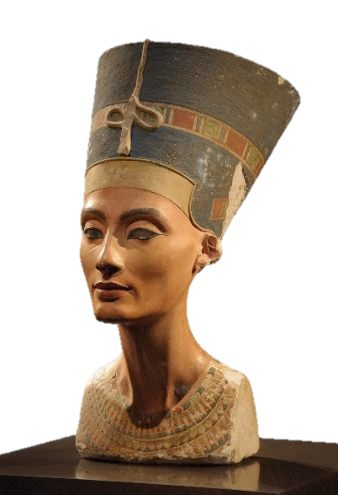
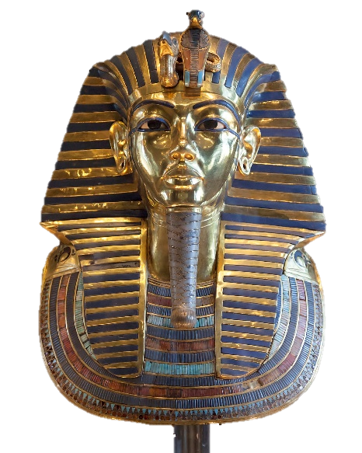
EGYPTIAN
GREEK
BYZANTINE
ROMAN
RENNAISSANCE
BAROQUE
MODERN PHILIPPINE
BUST OF NEFERTITI
c.1345 BCE) — Thutmose (workshop) — iconic Amarna portrait.
MASK OF TUTANKHAMUN
royal funerary mask (artist unknown; workshop of the king)

Slide 5
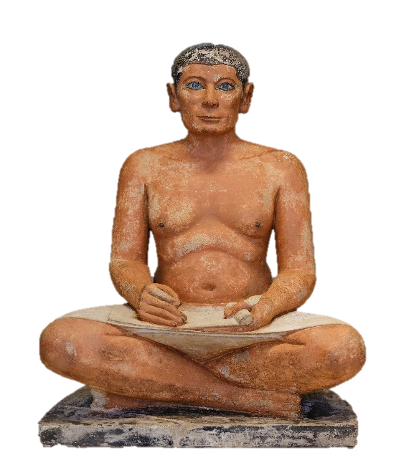
EGYPTIAN
GREEK
BYZANTINE
ROMAN
RENNAISSANCE
BAROQUE
MODERN PHILIPPINE
BUST OF NEFERTITI
MASK OF TUTANKHAMUN
c.1345 BCE) — Thutmose (workshop) — iconic Amarna portrait.
royal funerary mask (artist unknown; workshop of the king)
BUST OF NEFERTITI
c.1345 BCE) — Thutmose (workshop) — iconic Amarna portrait.

Slide 6
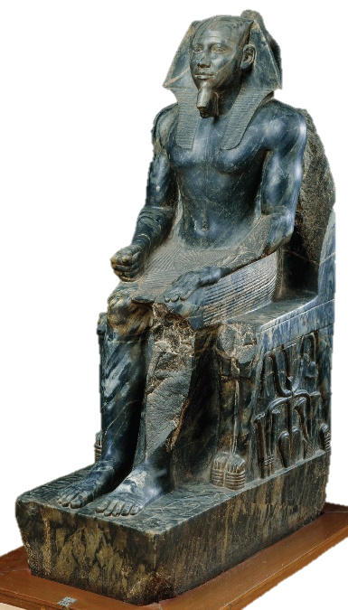
EGYPTIAN
GREEK
BYZANTINE
ROMAN
RENNAISSANCE
BAROQUE
MODERN PHILIPPINE
MASK OF TUTANKHAMUN
royal funerary mask (artist unknown; workshop of the king)
SEATED SCRIBE
anonymous, Louvre — famous for lifelike realism and crystal eyes.
KHAFRE ENTHRONED
anonymous royal “ka” statue, Egyptian Museum (Cairo)

Slide 7
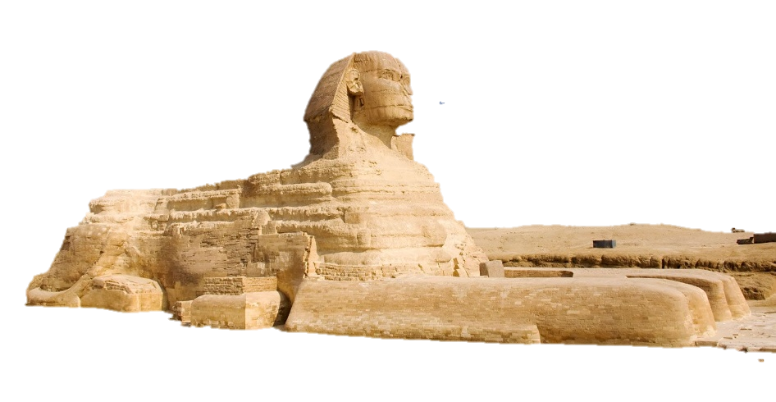
EGYPTIAN
GREEK
BYZANTINE
ROMAN
RENNAISSANCE
BAROQUE
MODERN PHILIPPINE
MASK OF TUTANKHAMUN
MASK OF TUTANKHAMUN
SEATED SCRIBE
royal funerary mask (artist unknown; workshop of the king)
KHAFRE ENTHRONED
anonymous, Louvre — famous for lifelike realism and crystal eyes.
anonymous royal “ka” statue, Egyptian Museum (Cairo)
GREAT SPHINX OF GIZA
monumental sphinx (likely Khafre’s face), anonymous carvers; a hybrid sculpture/monument

Slide 8
EGYPTIAN
GREEK
BYZANTINE
ROMAN
RENNAISSANCE
BAROQUE
MODERN PHILIPPINE
GREAT SPHINX OF GIZA
MASK OF TUTANKHAMUN
monumental sphinx (likely Khafre’s face), anonymous carvers; a hybrid sculpture/monument
SEATED SCRIBE
KHAFRE ENTHRONED
royal funerary mask (artist unknown; workshop of the king)
anonymous, Louvre — famous for lifelike realism and crystal eyes.
anonymous royal “ka” statue, Egyptian Museum (Cairo)

Slide 9
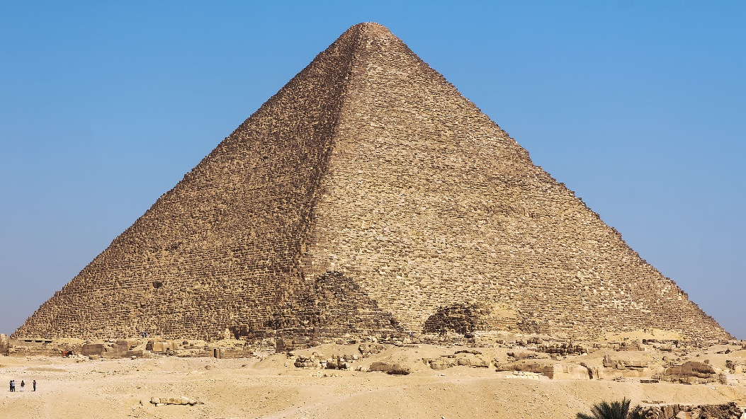
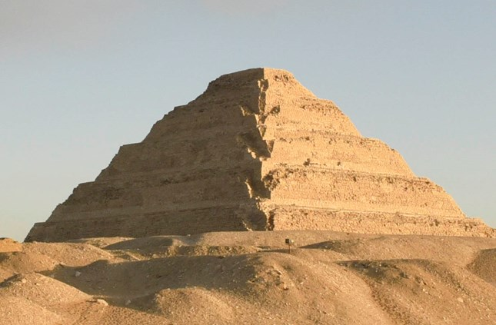
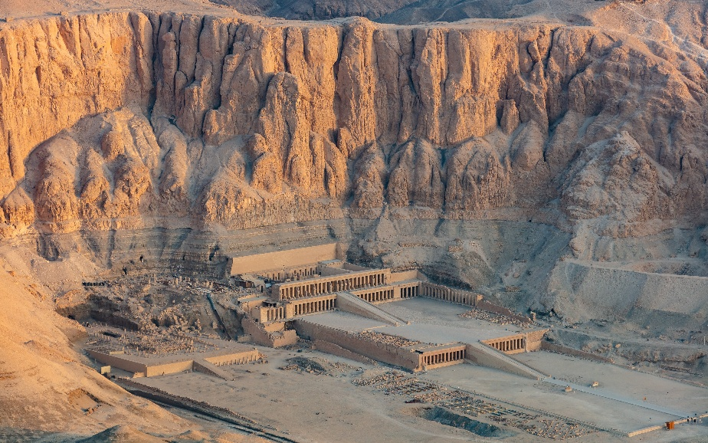
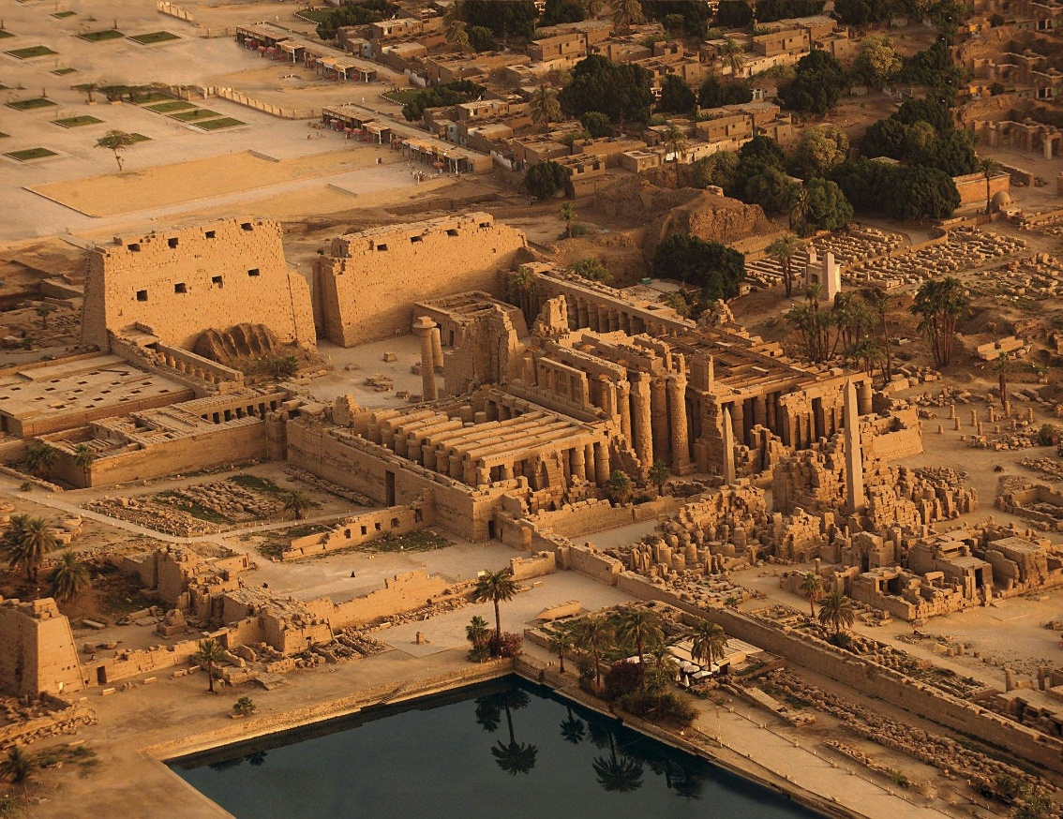
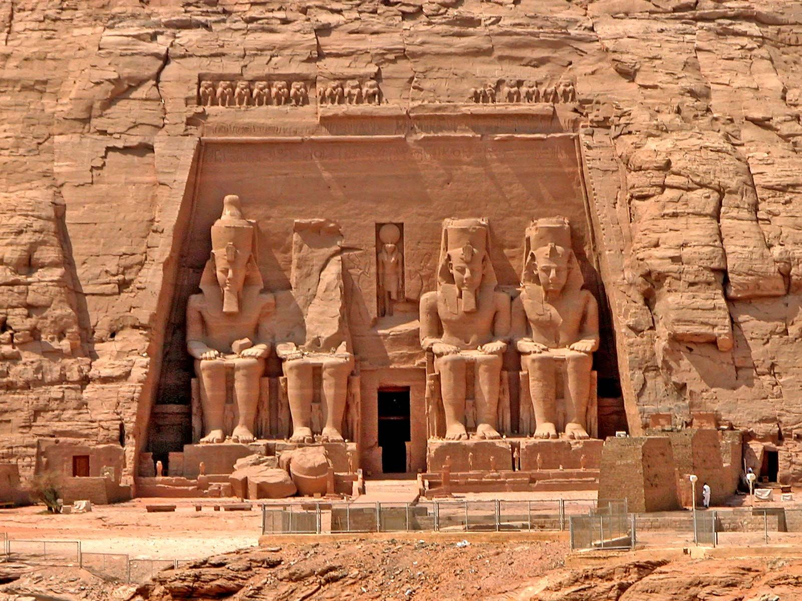
EGYPTIAN
GREEK
BYZANTINE
ROMAN
RENNAISSANCE
BAROQUE
MODERN PHILIPPINE

Slide 10
EGYPTIAN
GREEK
BYZANTINE
ROMAN
RENNAISSANCE
BAROQUE
MODERN PHILIPPINE
GREAT PYRAMID (KHUFU)
Giza; often credited to vizier Hemiunu (oversaw works) but attribution is not absolutely certain.
GREAT PYRAMID (KHUFU)
Giza; often credited to vizier Hemiunu (oversaw works) but attribution is not absolutely certain.

Slide 11
EGYPTIAN
GREEK
BYZANTINE
ROMAN
RENNAISSANCE
BAROQUE
MODERN PHILIPPINE

Slide 12
EGYPTIAN
GREEK
BYZANTINE
ROMAN
RENNAISSANCE
BAROQUE
MODERN PHILIPPINE
STEP PYRAMID OF DJOSER
(SAQQARA)
designed by Imhotep (earliest known named architect).

Slide 13
EGYPTIAN
GREEK
BYZANTINE
ROMAN
RENNAISSANCE
BAROQUE
MODERN PHILIPPINE

Slide 14
EGYPTIAN
GREEK
BYZANTINE
ROMAN
RENNAISSANCE
BAROQUE
MODERN PHILIPPINE
TEMPLE OF KARNAK
enormous, accretive temple complex built over centuries.

Slide 15
EGYPTIAN
GREEK
BYZANTINE
ROMAN
RENNAISSANCE
BAROQUE
MODERN PHILIPPINE

Slide 16
EGYPTIAN
GREEK
BYZANTINE
ROMAN
RENNAISSANCE
BAROQUE
MODERN PHILIPPINE
MORTUARY TEMPLE OF HATSHEPSUT
masterwork credited to Senenmut (Hatshepsut’s chief official/architect).

Slide 17
EGYPTIAN
GREEK
BYZANTINE
ROMAN
RENNAISSANCE
BAROQUE
MODERN PHILIPPINE

Slide 18
EGYPTIAN
GREEK
BYZANTINE
ROMAN
RENNAISSANCE
BAROQUE
MODERN PHILIPPINE
ABU SIMBEL
rock-cut temples with colossal seated Ramses — royal propaganda and solar alignments.

Slide 19
EGYPTIAN
GREEK
BYZANTINE
ROMAN
RENNAISSANCE
BAROQUE
MODERN PHILIPPINE

Slide 20
EGYPTIAN
GREEK
BYZANTINE
ROMAN
RENNAISSANCE
BAROQUE
MODERN PHILIPPINE

Slide 21
EGYPTIAN
BYZANTINE
ROMAN
RENNAISSANCE
BAROQUE
MODERN PHILIPPINE
GREEK

Slide 22
EGYPTIAN
BYZANTINE
ROMAN
RENNAISSANCE
BAROQUE
MODERN PHILIPPINE
GREEK
Arki – chief / master
Tekton – master builder

Slide 23
EGYPTIAN
BYZANTINE
ROMAN
RENNAISSANCE
BAROQUE
MODERN PHILIPPINE
GREEK SCULPTURES’ CHARACTERISTICS
IDEALISM
NATURALISM
MATERIALS
HUMAN-CENTERED
EXPRESSION

Slide 24
EGYPTIAN
BYZANTINE
ROMAN
RENNAISSANCE
BAROQUE
MODERN PHILIPPINE
GREEK SCULPTURES’ CHARACTERISTICS
IDEALISM
NATURALISM
MATERIALS
HUMAN-CENTERED
EXPRESSION

Slide 25
EGYPTIAN
BYZANTINE
ROMAN
RENNAISSANCE
BAROQUE
MODERN PHILIPPINE
GREEK SCULPTURES’ CHARACTERISTICS
IDEALISM
NATURALISM
MATERIALS
HUMAN-CENTERED
EXPRESSION

Slide 26
EGYPTIAN
BYZANTINE
ROMAN
RENNAISSANCE
BAROQUE
MODERN PHILIPPINE
GREEK SCULPTURES’ CHARACTERISTICS
IDEALISM
NATURALISM
MATERIALS
HUMAN-CENTERED
EXPRESSION

Slide 27
EGYPTIAN
BYZANTINE
ROMAN
RENNAISSANCE
BAROQUE
MODERN PHILIPPINE
GREEK SCULPTURES’ CHARACTERISTICS
IDEALISM
NATURALISM
MATERIALS
HUMAN-CENTERED
EXPRESSION

Slide 28
EGYPTIAN
BYZANTINE
ROMAN
RENNAISSANCE
BAROQUE
MODERN PHILIPPINE
GREEK SCULPTURES’ CHARACTERISTICS
IDEALISM
NATURALISM
MATERIALS
HUMAN-CENTERED
EXPRESSION

Slide 29
EGYPTIAN
BYZANTINE
ROMAN
RENNAISSANCE
BAROQUE
MODERN PHILIPPINE
GREEK SCULPTURES’ PERIOD
700-480 BCE
323-31 BCE
CLASSICAL PERIOD
ARCHAIC PERIOD
HELLENISTIC PERIOD
480-323 BCE

Slide 30
EGYPTIAN
BYZANTINE
ROMAN
RENNAISSANCE
BAROQUE
MODERN PHILIPPINE
GREEK SCULPTURES’ PERIOD
700-480 BCE
323-31 BCE
CLASSICAL PERIOD
ARCHAIC PERIOD
HELLENISTIC PERIOD
480-323 BCE

Slide 31
EGYPTIAN
BYZANTINE
ROMAN
RENNAISSANCE
BAROQUE
MODERN PHILIPPINE
GREEK SCULPTURES’ PERIOD
700-480 BCE
323-31 BCE
CLASSICAL PERIOD
ARCHAIC PERIOD
HELLENISTIC PERIOD
480-323 BCE

Slide 32
EGYPTIAN
BYZANTINE
ROMAN
RENNAISSANCE
BAROQUE
MODERN PHILIPPINE
GREEK SCULPTURES’ PERIOD
700-480 BCE
323-31 BCE
CLASSICAL PERIOD
ARCHAIC PERIOD
HELLENISTIC PERIOD
480-323 BCE

Slide 33
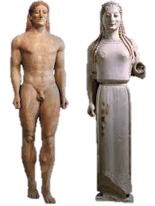
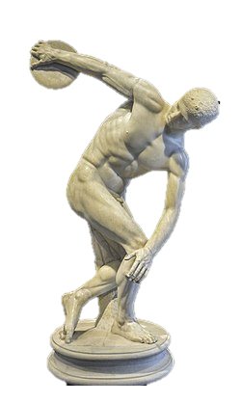
EGYPTIAN
GREEK
BYZANTINE
ROMAN
RENNAISSANCE
BAROQUE
MODERN PHILIPPINE
KOUROS AND KORE
DISCOBOLUS

Slide 34
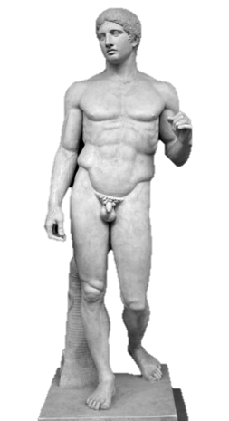
EGYPTIAN
GREEK
BYZANTINE
ROMAN
RENNAISSANCE
BAROQUE
MODERN PHILIPPINE
KOUROS AND KORE
DISCOBOLUS
DORYPHOROS

Slide 35
EGYPTIAN
GREEK
BYZANTINE
ROMAN
RENNAISSANCE
BAROQUE
MODERN PHILIPPINE
DISCOBOLUS
DORYPHOROS

Slide 36
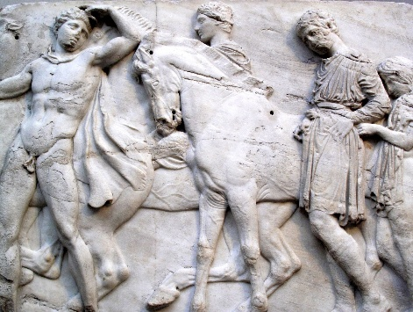
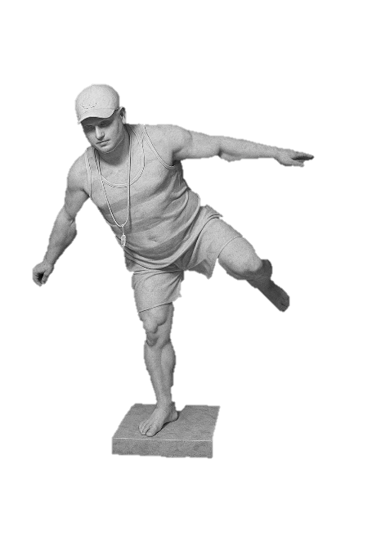
EGYPTIAN
GREEK
BYZANTINE
ROMAN
RENNAISSANCE
BAROQUE
MODERN PHILIPPINE
DORYPHOROS
PARTHENON SCULPTURES
DISCOBOLUS
DURANTE
GULAPA

Slide 37
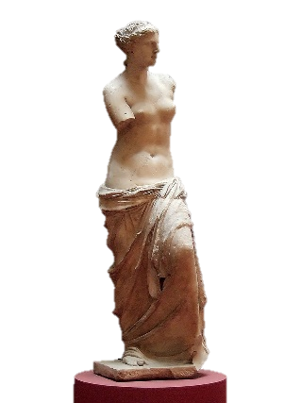
EGYPTIAN
GREEK
BYZANTINE
ROMAN
RENNAISSANCE
BAROQUE
MODERN PHILIPPINE
PARTHENON SCULPTURES
DURANTE
GULAPA
DORYPHOROS
DISCOBOLUS
VENUS DE MILO

Slide 38
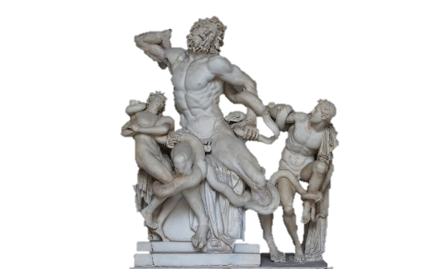
EGYPTIAN
GREEK
BYZANTINE
ROMAN
RENNAISSANCE
BAROQUE
MODERN PHILIPPINE
DORYPHOROS
VENUS DE MILO
DISCOBOLUS
DURANTE
GULAPA
LAOCOÖN AND HIS SONS

Slide 39
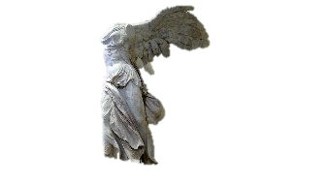
EGYPTIAN
GREEK
BYZANTINE
ROMAN
RENNAISSANCE
BAROQUE
MODERN PHILIPPINE
VENUS DE MILO
LAOCOÖN AND HIS SONS
DORYPHOROS
DISCOBOLUS
DURANTE
GULAPA
WINGED VICTORY OF SAMOTHRACE

Slide 40
EGYPTIAN
GREEK
BYZANTINE
ROMAN
RENNAISSANCE
BAROQUE
MODERN PHILIPPINE
LAOCOÖN AND HIS SONS
VENUS DE MILO
WINGED VICTORY OF SAMOTHRACE
DORYPHOROS
DISCOBOLUS
DURANTE
GULAPA

Slide 41
EGYPTIAN
GREEK
BYZANTINE
ROMAN
RENNAISSANCE
BAROQUE
MODERN PHILIPPINE
LEGACY
LAOCOÖN AND HIS SONS
VENUS DE MILO
Set the standard for Western art: ideal beauty, humanism, proportion.
DORYPHOROS
DISCOBOLUS
Inspired Roman sculpture, which often copied Greek originals.

Slide 42
EGYPTIAN
GREEK
BYZANTINE
ROMAN
RENNAISSANCE
BAROQUE
MODERN PHILIPPINE
LEGACY
LAOCOÖN AND HIS SONS
VENUS DE MILO
Set the standard for Western art: ideal beauty, humanism, proportion.
DORYPHOROS
DISCOBOLUS
Inspired Roman sculpture, which often copied Greek originals.

Slide 43
EGYPTIAN
GREEK
BYZANTINE
ROMAN
RENNAISSANCE
BAROQUE
MODERN PHILIPPINE
LEGACY
LAOCOÖN AND HIS SONS
VENUS DE MILO
Influenced Renaissance and Neoclassical art.
DORYPHOROS
DISCOBOLUS
Continue to shape modern concepts of beauty and the human form.

Slide 44
EGYPTIAN
GREEK
BYZANTINE
ROMAN
RENNAISSANCE
BAROQUE
MODERN PHILIPPINE
LEGACY
LAOCOÖN AND HIS SONS
VENUS DE MILO
Influenced Renaissance and Neoclassical art.
DORYPHOROS
DISCOBOLUS
Continue to shape modern concepts of beauty and the human form.

Slide 45
EGYPTIAN
BYZANTINE
ROMAN
RENNAISSANCE
BAROQUE
MODERN PHILIPPINE
GREEK ARCHITECTURE’ CHARACTERISTICS
HARMONIC
BALANCE
PROPORTIONATE
POST AND LINTEL
MARBLE & LIMESTONE
TEMPLE AS HOUSE OF GODS

Slide 46
EGYPTIAN
BYZANTINE
ROMAN
RENNAISSANCE
BAROQUE
MODERN PHILIPPINE
GREEK ARCHITECTURE’ CHARACTERISTICS
HARMONIC
BALANCE
PROPORTIONATE
POST AND LINTEL
MARBLE & LIMESTONE
TEMPLE AS HOUSE OF GODS

Slide 47
EGYPTIAN
BYZANTINE
ROMAN
RENNAISSANCE
BAROQUE
MODERN PHILIPPINE
GREEK ARCHITECTURE’ CHARACTERISTICS
HARMONIC
BALANCE
PROPORTIONATE
POST AND LINTEL
MARBLE & LIMESTONE
TEMPLE AS HOUSE OF GODS

Slide 48
EGYPTIAN
BYZANTINE
ROMAN
RENNAISSANCE
BAROQUE
MODERN PHILIPPINE
GREEK ARCHITECTURE’ CHARACTERISTICS
HARMONIC
BALANCE
PROPORTIONATE
POST AND LINTEL
MARBLE & LIMESTONE
TEMPLE AS HOUSE OF GODS

Slide 49
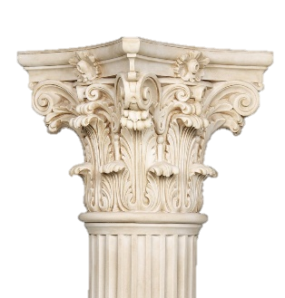
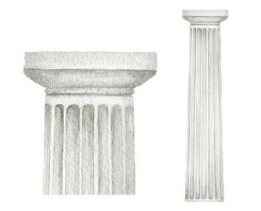
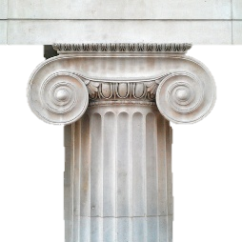
EGYPTIAN
BYZANTINE
ROMAN
RENNAISSANCE
BAROQUE
MODERN PHILIPPINE
THREE CLASSICAL ORDER
DORIC
IONIC
CORINTHIAN

Slide 50
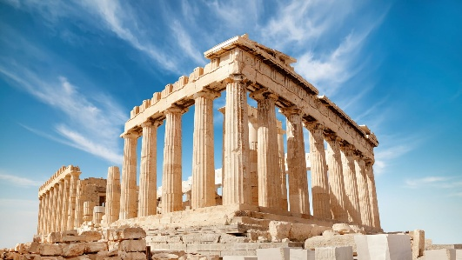
EGYPTIAN
GREEK
BYZANTINE
ROMAN
RENNAISSANCE
BAROQUE
MODERN PHILIPPINE
PARTHENON
DISCOBOLUS

Slide 51
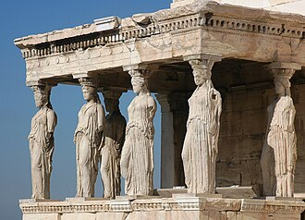
EGYPTIAN
GREEK
BYZANTINE
ROMAN
RENNAISSANCE
BAROQUE
MODERN PHILIPPINE
ERECHTHEION

Slide 52
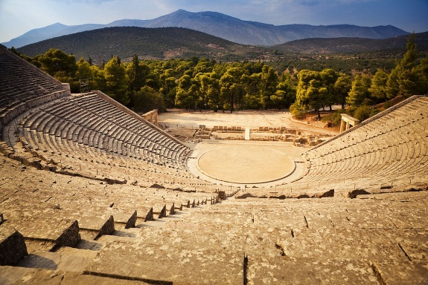
EGYPTIAN
GREEK
BYZANTINE
ROMAN
RENNAISSANCE
BAROQUE
MODERN PHILIPPINE
THEATRE OF EPIDAURUS
DISCOBOLUS

Slide 53
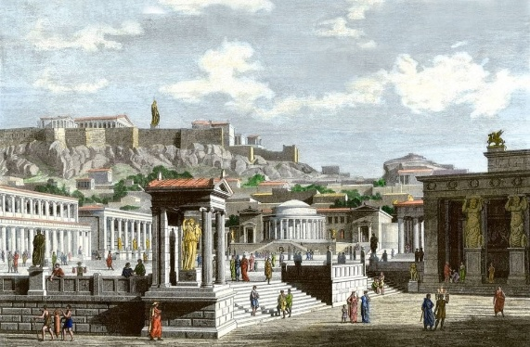
EGYPTIAN
GREEK
BYZANTINE
ROMAN
RENNAISSANCE
BAROQUE
MODERN PHILIPPINE
AGORAS & STOAS
DISCOBOLUS

Slide 54
EGYPTIAN
GREEK
BYZANTINE
ROMAN
RENNAISSANCE
BAROQUE
MODERN PHILIPPINE
FUNCTIONS
TEMPLES
PUBLIC USE
CULTURAL

Slide 55
EGYPTIAN
GREEK
BYZANTINE
ROMAN
RENNAISSANCE
BAROQUE
MODERN PHILIPPINE
FUNCTIONS
TEMPLES
PUBLIC USE
CULTURAL

Slide 56
EGYPTIAN
GREEK
BYZANTINE
ROMAN
RENNAISSANCE
BAROQUE
MODERN PHILIPPINE
FUNCTIONS
TEMPLES
PUBLIC USE
CULTURAL

Slide 57
EGYPTIAN
GREEK
BYZANTINE
ROMAN
RENNAISSANCE
BAROQUE
MODERN PHILIPPINE
LEGACY
The Romans loved it!
Basis for neoclassical styles in government buildings, museums, universities worldwide.

Slide 58
EGYPTIAN
GREEK
BYZANTINE
ROMAN
RENNAISSANCE
BAROQUE
MODERN PHILIPPINE
LEGACY
The Romans loved it!
Basis for neoclassical styles in government buildings, museums, universities worldwide.

Slide 59
EGYPTIAN
GREEK
BYZANTINE
ROMAN
RENNAISSANCE
BAROQUE
MODERN PHILIPPINE
Connection Between Greek Definitions & Architecture
Architecture itself shows the Greek pursuit of clarity, order, and meaning.
Greek architecture reflects the root values of their society: balance, beauty, and functionality.

Slide 60
EGYPTIAN
GREEK
BYZANTINE
ROMAN
RENNAISSANCE
BAROQUE
MODERN PHILIPPINE
Connection Between Greek Definitions & Architecture
Architecture itself shows the Greek pursuit of clarity, order, and meaning.
Greek architecture reflects the root values of their society: balance, beauty, and functionality.

Slide 61
EGYPTIAN
GREEK
ROMAN
RENNAISSANCE
BAROQUE
MODERN PHILIPPINE
BYZANTINE
DISCOBOLUS

Slide 62
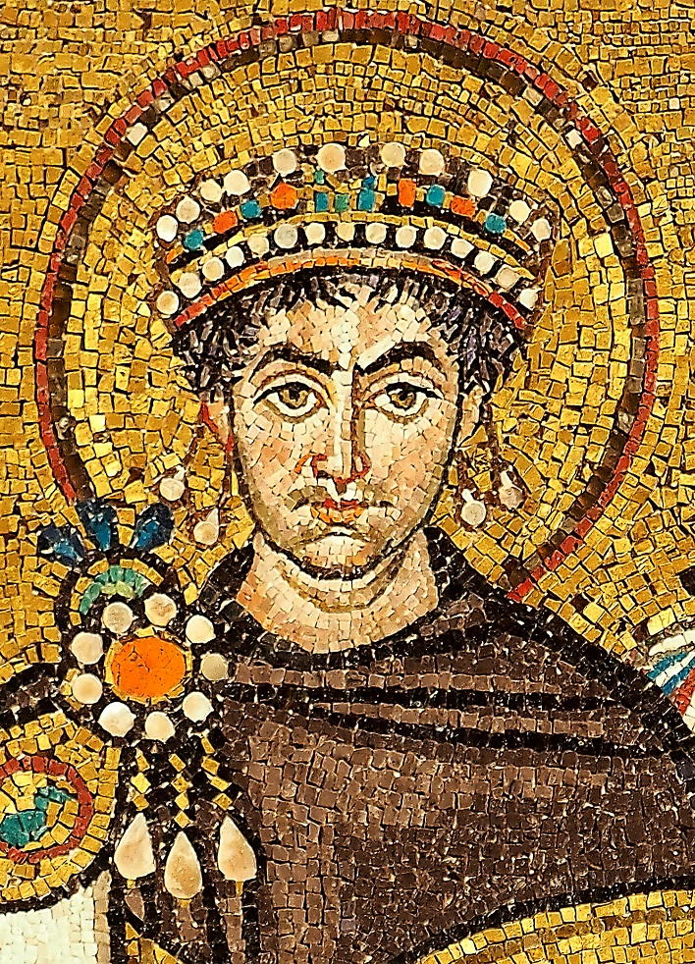
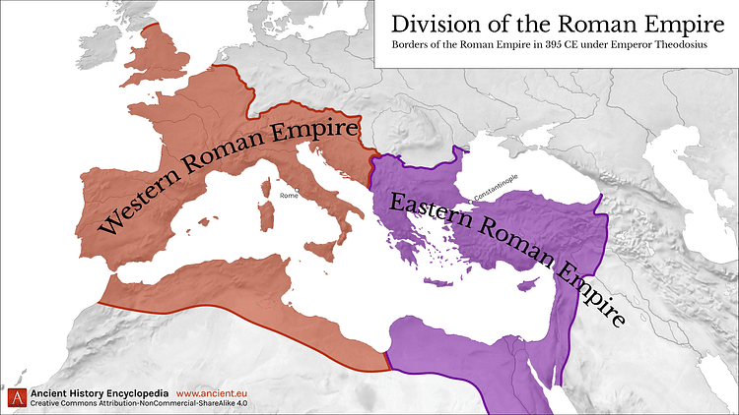
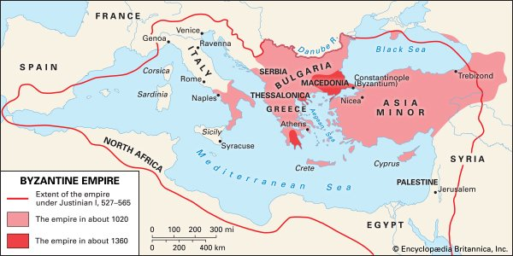
EGYPTIAN
GREEK
BYZANTINE
ROMAN
RENNAISSANCE
BAROQUE
MODERN PHILIPPINE
BRIEF HISTORY
330 -527 CE
565 – 867 CE
527 – 565 CE

Slide 63
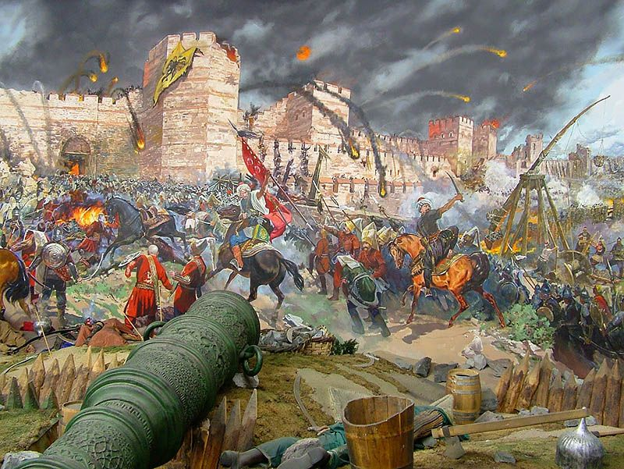
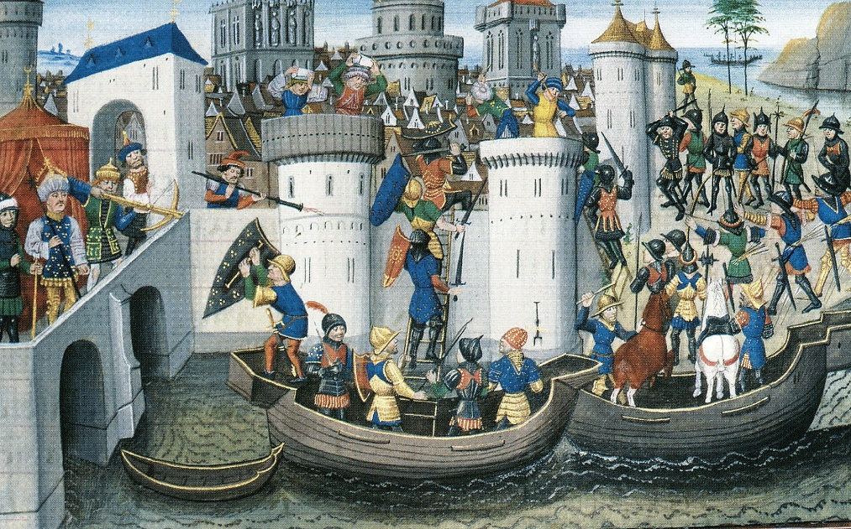
EGYPTIAN
GREEK
BYZANTINE
ROMAN
RENNAISSANCE
BAROQUE
MODERN PHILIPPINE
BRIEF HISTORY
1056 – 1204 CE
1261 – 1453 CE

Slide 64
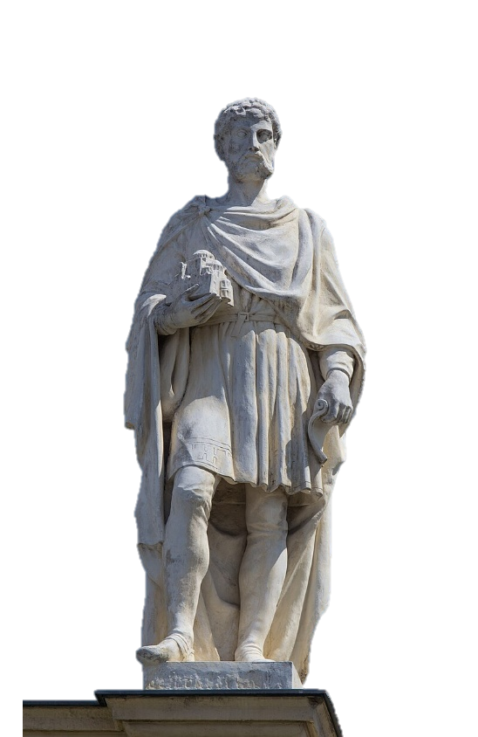
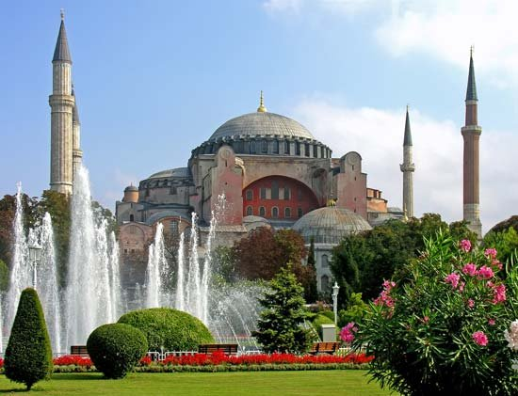
EGYPTIAN
GREEK
BYZANTINE
ROMAN
RENNAISSANCE
BAROQUE
MODERN PHILIPPINE
Isidore of Miletus and the Hagia Sophia

Slide 65
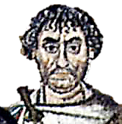
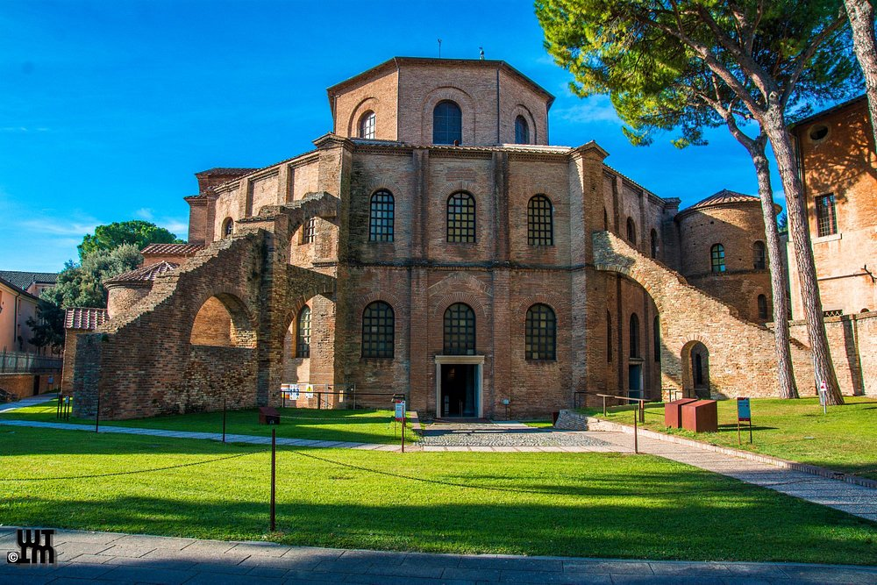
EGYPTIAN
GREEK
BYZANTINE
ROMAN
RENNAISSANCE
BAROQUE
MODERN PHILIPPINE
Julianus Argentarius

Slide 66
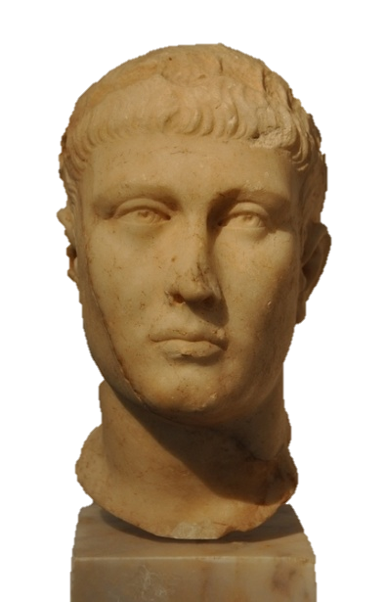
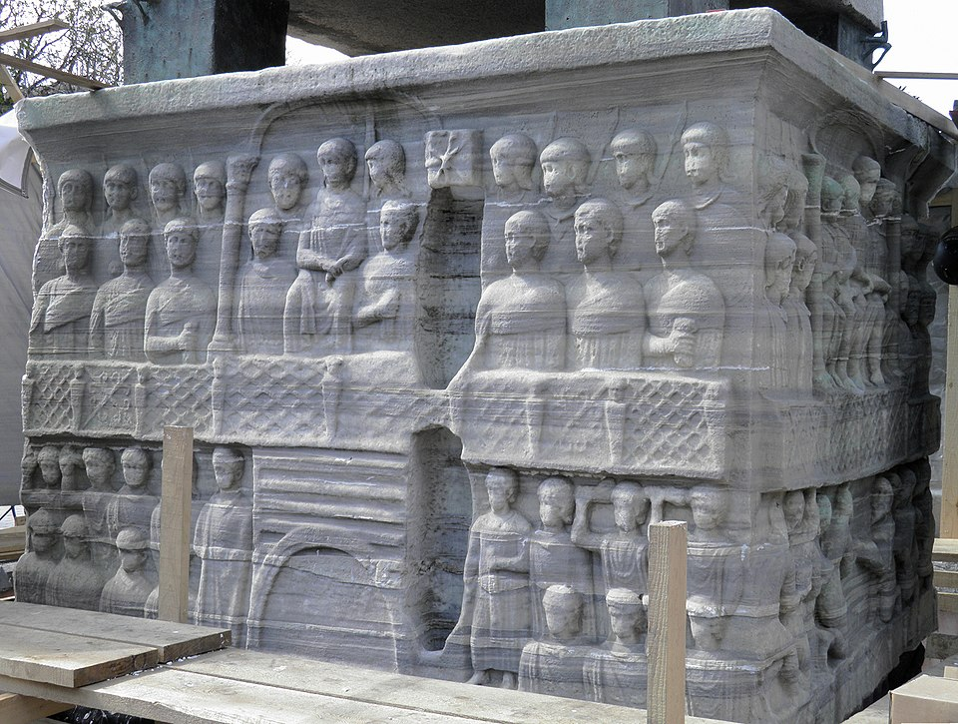
EGYPTIAN
GREEK
BYZANTINE
ROMAN
RENNAISSANCE
BAROQUE
MODERN PHILIPPINE
Theodosius I

Slide 67
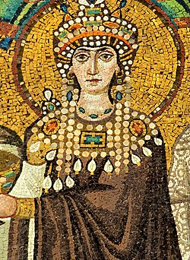
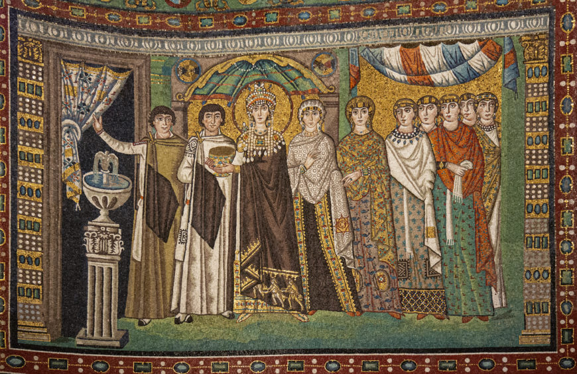
EGYPTIAN
GREEK
BYZANTINE
ROMAN
RENNAISSANCE
BAROQUE
MODERN PHILIPPINE
Theodora

Slide 68
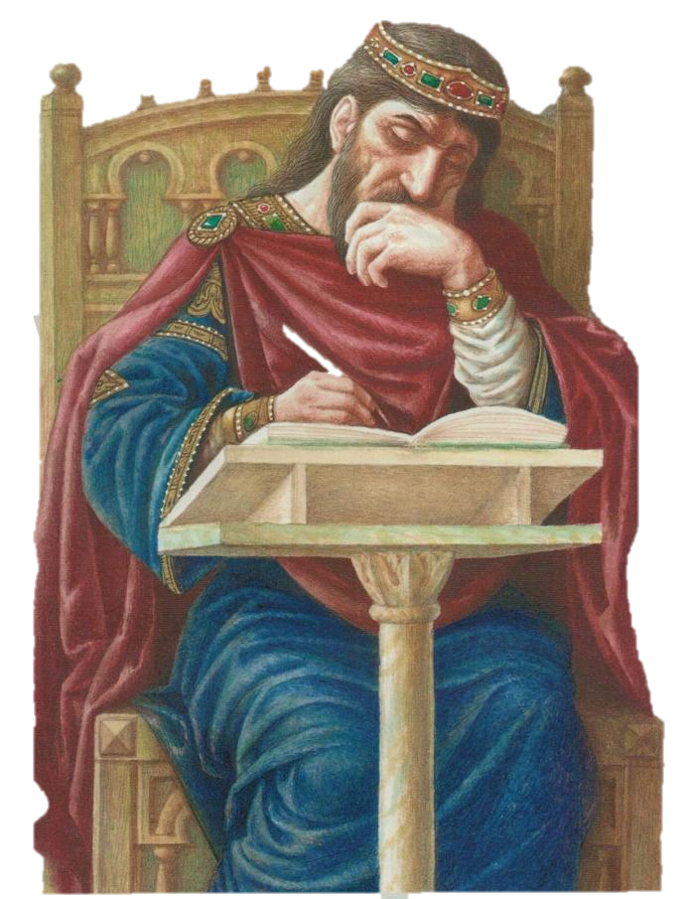
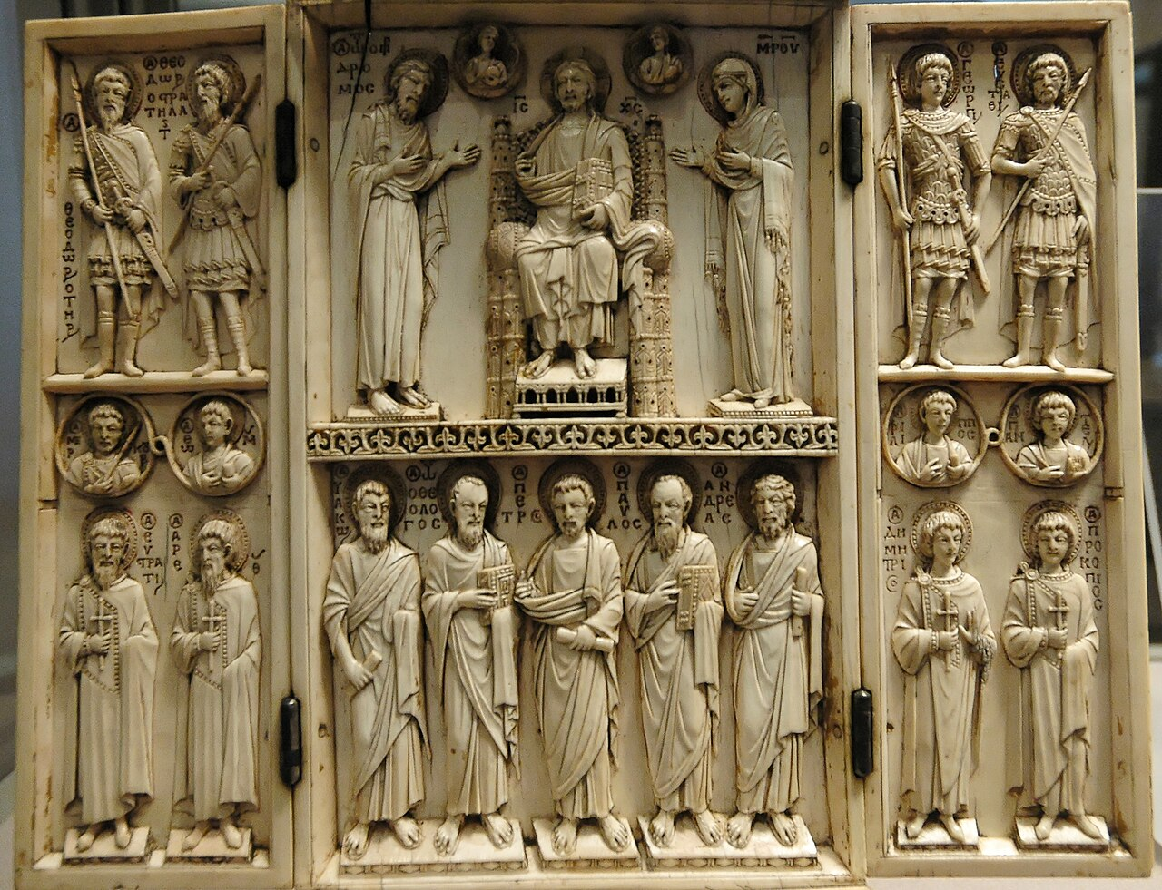
EGYPTIAN
GREEK
BYZANTINE
ROMAN
RENNAISSANCE
BAROQUE
MODERN PHILIPPINE
Leo VI "the Wise"

Slide 69
EGYPTIAN
GREEK
BYZANTINE
RENNAISSANCE
BAROQUE
MODERN PHILIPPINE
ROMAN

Slide 70
EGYPTIAN
GREEK
BYZANTINE
ROMAN
RENNAISSANCE
BAROQUE
MODERN PHILIPPINE
ROMAN SCULPTURE CHARACTERISTICS
STRONGLY INFLUENCED BY GREEK
EMPHASIS ON INDIVIDUALS AND PORTRAITS
USED AS POLITICAL PROPAGANDA

Slide 71
EGYPTIAN
GREEK
BYZANTINE
ROMAN
RENNAISSANCE
BAROQUE
MODERN PHILIPPINE
ROMAN SCULPTURE CHARACTERISTICS
STRONGLY INFLUENCED BY GREEK
EMPHASIS ON INDIVIDUALS AND PORTRAITS
USED AS POLITICAL PROPAGANDA

Slide 72
EGYPTIAN
GREEK
BYZANTINE
ROMAN
RENNAISSANCE
BAROQUE
MODERN PHILIPPINE
ROMAN SCULPTURE CHARACTERISTICS
STRONGLY INFLUENCED BY GREEK
EMPHASIS ON INDIVIDUALS AND PORTRAITS
USED AS POLITICAL PROPAGANDA

Slide 73
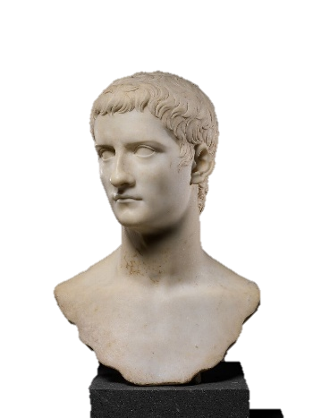
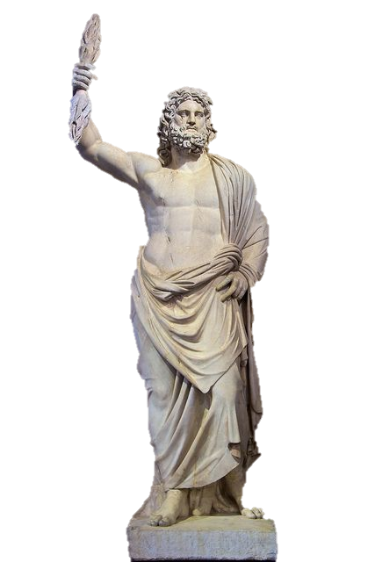
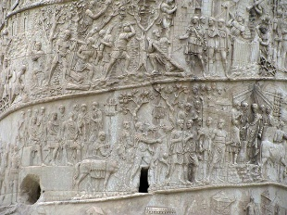
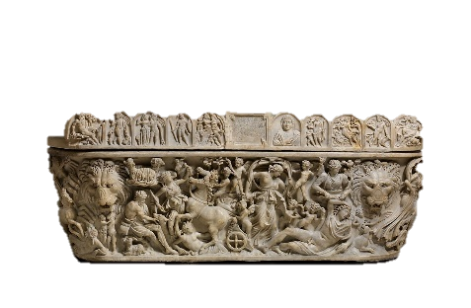
EGYPTIAN
GREEK
BYZANTINE
ROMAN
RENNAISSANCE
BAROQUE
MODERN PHILIPPINE
TYPES OF SCULPTURE
PORTRAITS
RELIEFS
STATUE OF GODS
FUNENARY ART

Slide 74
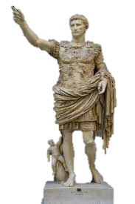
EGYPTIAN
GREEK
BYZANTINE
ROMAN
RENNAISSANCE
BAROQUE
MODERN PHILIPPINE
AUGUSTUS OF PRIMA PORTA

Slide 75
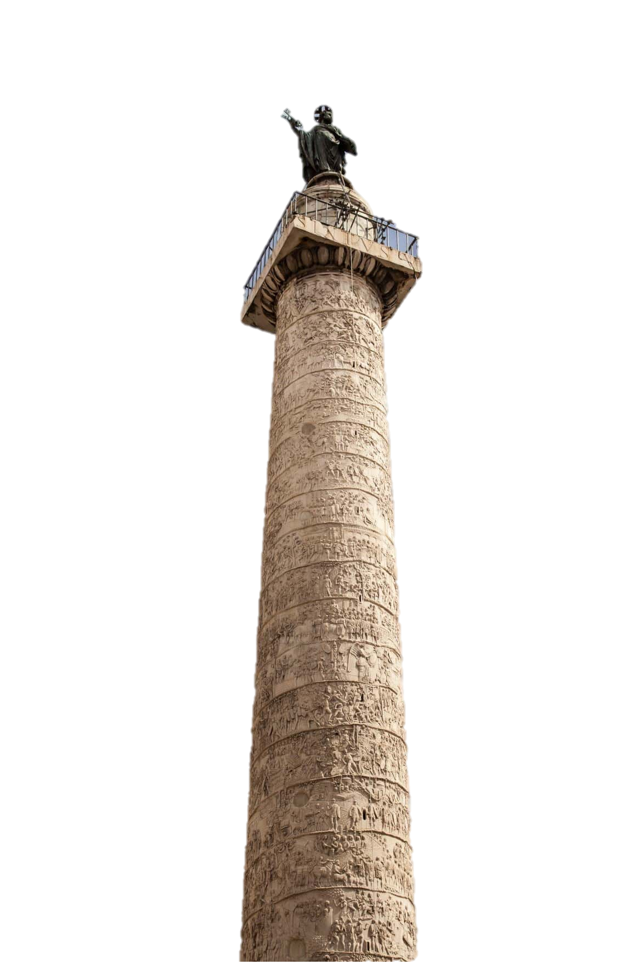
EGYPTIAN
GREEK
BYZANTINE
ROMAN
RENNAISSANCE
BAROQUE
MODERN PHILIPPINE
TRAJAN’S COLUMN

Slide 76
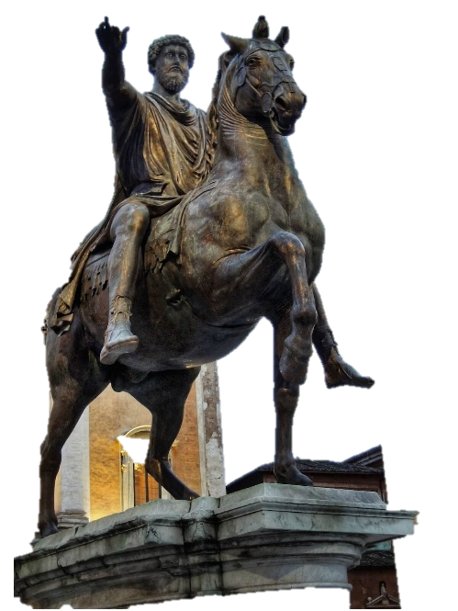
EGYPTIAN
GREEK
BYZANTINE
ROMAN
RENNAISSANCE
BAROQUE
MODERN PHILIPPINE
EQUESTRIAN STATUE OF MARCUS AURELIUS

Slide 77
EGYPTIAN
GREEK
BYZANTINE
ROMAN
RENNAISSANCE
BAROQUE
MODERN PHILIPPINE
ROMAN ARCHITECTURE CHARACTERISTICS
BORROWED GREEK COLUMNS AND STYLES
MASTERY OF CONCRETE
FOCUSED ON FUNCTIONALITY AND GRANDEUR.
USED ARCHES, VAULTS, AND DOMES

Slide 78
EGYPTIAN
GREEK
BYZANTINE
ROMAN
RENNAISSANCE
BAROQUE
MODERN PHILIPPINE
ROMAN ARCHITECTURE CHARACTERISTICS
BORROWED GREEK COLUMNS AND STYLES
MASTERY OF CONCRETE
FOCUSED ON FUNCTIONALITY AND GRANDEUR.
USED ARCHES, VAULTS, AND DOMES

Slide 79
EGYPTIAN
GREEK
BYZANTINE
ROMAN
RENNAISSANCE
BAROQUE
MODERN PHILIPPINE
ROMAN ARCHITECTURE CHARACTERISTICS
BORROWED GREEK COLUMNS AND STYLES
MASTERY OF CONCRETE
FOCUSED ON FUNCTIONALITY AND GRANDEUR.
USED ARCHES, VAULTS, AND DOMES

Slide 80
EGYPTIAN
GREEK
BYZANTINE
ROMAN
RENNAISSANCE
BAROQUE
MODERN PHILIPPINE
ROMAN ARCHITECTURE CHARACTERISTICS
BORROWED GREEK COLUMNS AND STYLES
MASTERY OF CONCRETE
FOCUSED ON FUNCTIONALITY AND GRANDEUR.
USED ARCHES, VAULTS, AND DOMES

Slide 81
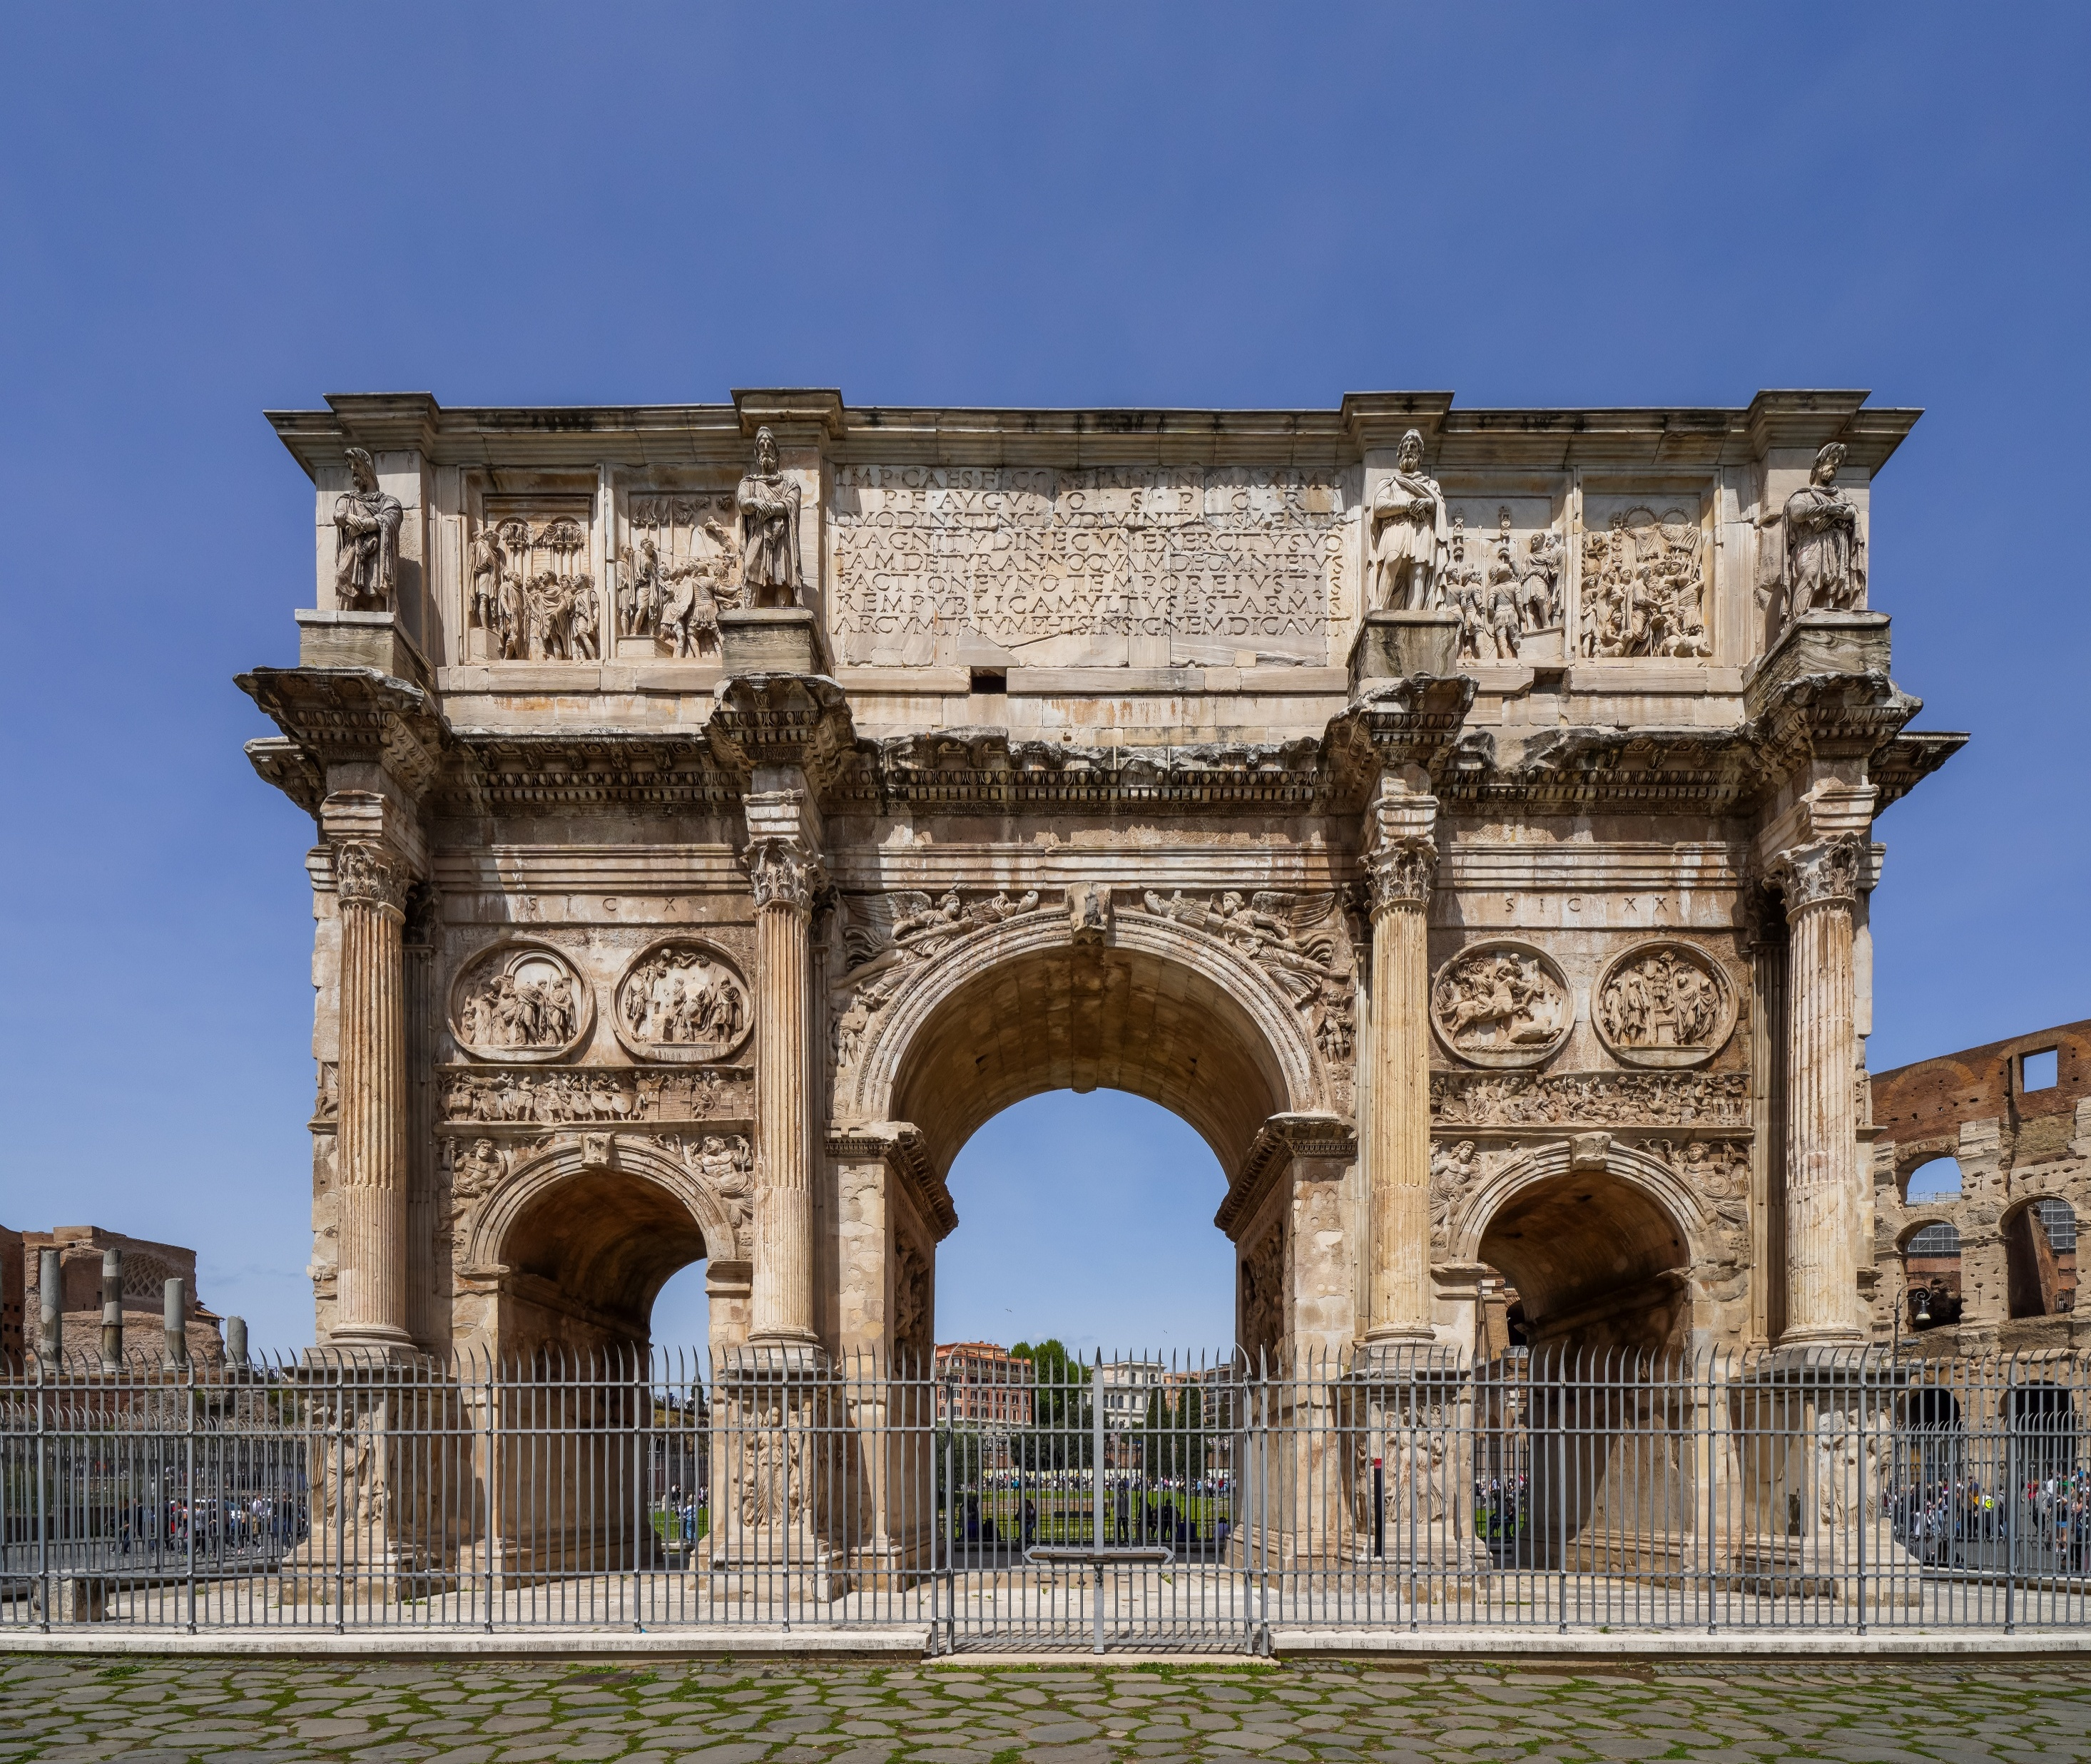





EGYPTIAN
GREEK
BYZANTINE
ROMAN
RENNAISSANCE
BAROQUE
MODERN PHILIPPINE
KEY FEATURES & CONTRIBUTIONS

Slide 82

EGYPTIAN
GREEK
BYZANTINE
ROMAN
RENNAISSANCE
BAROQUE
MODERN PHILIPPINE
COLOSSEUM

Slide 83

EGYPTIAN
GREEK
BYZANTINE
ROMAN
RENNAISSANCE
BAROQUE
MODERN PHILIPPINE
PANTHEON

Slide 84

EGYPTIAN
GREEK
BYZANTINE
ROMAN
RENNAISSANCE
BAROQUE
MODERN PHILIPPINE
AQUEDUCTS

Slide 85

EGYPTIAN
GREEK
BYZANTINE
ROMAN
RENNAISSANCE
BAROQUE
MODERN PHILIPPINE
ROMAN BATHS

Slide 86

EGYPTIAN
GREEK
BYZANTINE
ROMAN
RENNAISSANCE
BAROQUE
MODERN PHILIPPINE
TRIUMPHAL ARCHES

Slide 87
EGYPTIAN
GREEK
BYZANTINE
ROMAN
RENNAISSANCE
BAROQUE
MODERN PHILIPPINE
LEGACY
foundation of portraiture and propaganda in Western art.
influenced government buildings, cathedrals, and public works worldwide.
Their engineering (arches, domes, concrete) is still used today.

Slide 88
EGYPTIAN
GREEK
BYZANTINE
ROMAN
RENNAISSANCE
BAROQUE
MODERN PHILIPPINE
LEGACY
foundation of portraiture and propaganda in Western art.
influenced government buildings, cathedrals, and public works worldwide.
Their engineering (arches, domes, concrete) is still used today.

Slide 89
EGYPTIAN
GREEK
BYZANTINE
ROMAN
RENNAISSANCE
BAROQUE
MODERN PHILIPPINE
LEGACY
foundation of portraiture and propaganda in Western art.
influenced government buildings, cathedrals, and public works worldwide.
Their engineering (arches, domes, concrete) is still used today.

Slide 90
EGYPTIAN
GREEK
BYZANTINE
ROMAN
BAROQUE
MODERN PHILIPPINE
RENNAISSANCE

Slide 91
EGYPTIAN
GREEK
BYZANTINE
ROMAN
BAROQUE
MODERN PHILIPPINE
RENNAISSANCE
“Rebirth” of Greek and Roman art and knowledge after the middle ages.

Slide 92
EGYPTIAN
GREEK
BYZANTINE
ROMAN
RENNAISSANCE
BAROQUE
MODERN PHILIPPINE
RENNAISANCE SCULPTURE CHARACTERISTICS
REASON, PROPORTION, AND NATURAL BEAUTY.
REALISTIC ANATOMY, BALANCED POSES (CONTRAPPOSTO).
CALM, IDEALIZED FIGURES; HARMONY BETWEEN RELIGION AND CLASSICAL IDEALS.

Slide 93
EGYPTIAN
GREEK
BYZANTINE
ROMAN
RENNAISSANCE
BAROQUE
MODERN PHILIPPINE
RENNAISANCE SCULPTURE CHARACTERISTICS
REASON, PROPORTION, AND NATURAL BEAUTY.
REALISTIC ANATOMY, BALANCED POSES (CONTRAPPOSTO).
CALM, IDEALIZED FIGURES; HARMONY BETWEEN RELIGION AND CLASSICAL IDEALS.

Slide 94
EGYPTIAN
GREEK
BYZANTINE
ROMAN
RENNAISSANCE
BAROQUE
MODERN PHILIPPINE
RENNAISANCE SCULPTURE CHARACTERISTICS
REASON, PROPORTION, AND NATURAL BEAUTY.
REALISTIC ANATOMY, BALANCED POSES (CONTRAPPOSTO).
CALM, IDEALIZED FIGURES; HARMONY BETWEEN RELIGION AND CLASSICAL IDEALS.

Slide 95

EGYPTIAN
GREEK
BYZANTINE
ROMAN
RENNAISSANCE
BAROQUE
MODERN PHILIPPINE
DAVID

Slide 96

EGYPTIAN
GREEK
BYZANTINE
ROMAN
RENNAISSANCE
BAROQUE
MODERN PHILIPPINE
GATTAMELATA

Slide 97

EGYPTIAN
GREEK
BYZANTINE
ROMAN
RENNAISSANCE
BAROQUE
MODERN PHILIPPINE
GHIBERTI

Slide 98
EGYPTIAN
GREEK
BYZANTINE
ROMAN
RENNAISSANCE
BAROQUE
MODERN PHILIPPINE
RENNAISANCE ARCHITECTURE CHARACTERISTICS
INSPIRED BY ROMAN SYMMETRY AND GEOMETRY.
USE OF DOMES, ARCHES, COLUMNS, AND PERFECT PROPORTIONS.

Slide 99
EGYPTIAN
GREEK
BYZANTINE
ROMAN
RENNAISSANCE
BAROQUE
MODERN PHILIPPINE
RENNAISANCE ARCHITECTURE CHARACTERISTICS
INSPIRED BY ROMAN SYMMETRY AND GEOMETRY.
USE OF DOMES, ARCHES, COLUMNS, AND PERFECT PROPORTIONS.

Slide 100

EGYPTIAN
GREEK
BYZANTINE
ROMAN
RENNAISSANCE
BAROQUE
MODERN PHILIPPINE
FLORENCE CATHEDRAL DOME

Slide 101

EGYPTIAN
GREEK
BYZANTINE
ROMAN
RENNAISSANCE
BAROQUE
MODERN PHILIPPINE
SANTA MARIA NOVELLA FACADE

Slide 102

EGYPTIAN
GREEK
BYZANTINE
ROMAN
RENNAISSANCE
BAROQUE
MODERN PHILIPPINE
VILLA ROTONDA

Slide 103
EGYPTIAN
GREEK
BYZANTINE
ROMAN
RENNAISSANCE
MODERN PHILIPPINE
BAROQUE

Slide 104
EGYPTIAN
GREEK
BYZANTINE
ROMAN
RENNAISSANCE
MODERN PHILIPPINE
BAROQUE
EMERGE IN ROME DURING THE COUNTER REFORMATION.
AIMED TO AWE AND MOVE VIEWERS; ART AS EMOTIONAL PERSUASION.
CHARACTERIZED BY DRAMA, GRANDEUR AND MOTION.

Slide 105
EGYPTIAN
GREEK
BYZANTINE
ROMAN
RENNAISSANCE
MODERN PHILIPPINE
BAROQUE
EMERGE IN ROME DURING THE COUNTER REFORMATION.
AIMED TO AWE AND MOVE VIEWERS; ART AS EMOTIONAL PERSUASION.
CHARACTERIZED BY DRAMA, GRANDEUR AND MOTION.

Slide 106
EGYPTIAN
GREEK
BYZANTINE
ROMAN
RENNAISSANCE
MODERN PHILIPPINE
BAROQUE
EMERGE IN ROME DURING THE COUNTER REFORMATION.
AIMED TO AWE AND MOVE VIEWERS; ART AS EMOTIONAL PERSUASION.
CHARACTERIZED BY DRAMA, GRANDEUR AND MOTION.

Slide 107
EGYPTIAN
GREEK
BYZANTINE
ROMAN
RENNAISSANCE
BAROQUE
MODERN PHILIPPINE
BAROQUE SCULPTURE CHARACTERISTICS
DYNAMIC MOVEMENT, TWISTING FIGURES, STRONG LIGHT-SHADOW EFFECTS.
EMOTIONAL INTENSITY; CAPTURES MOMENTS OF ACTION.

Slide 108
EGYPTIAN
GREEK
BYZANTINE
ROMAN
RENNAISSANCE
BAROQUE
MODERN PHILIPPINE
BAROQUE SCULPTURE CHARACTERISTICS
DYNAMIC MOVEMENT, TWISTING FIGURES, STRONG LIGHT-SHADOW EFFECTS.
EMOTIONAL INTENSITY; CAPTURES MOMENTS OF ACTION.

Slide 109

EGYPTIAN
GREEK
BYZANTINE
ROMAN
RENNAISSANCE
BAROQUE
MODERN PHILIPPINE
ECSTASY OF SAINT TERESA

Slide 110

EGYPTIAN
GREEK
BYZANTINE
ROMAN
RENNAISSANCE
BAROQUE
MODERN PHILIPPINE
ST. VERONICA

Slide 111
EGYPTIAN
GREEK
BYZANTINE
ROMAN
RENNAISSANCE
BAROQUE
MODERN PHILIPPINE
BAROQUE ARCHITECTURE CHARACTERISTICS
GRAND SCALE, CURVED FACADES, OVALS, SPIRALS, AND RICH DECORATION.
INTEGRATION OF PAINTING, SCULPTURE, AND ARCHITECTURE FOR TOTAL IMPACT.

Slide 112
EGYPTIAN
GREEK
BYZANTINE
ROMAN
RENNAISSANCE
BAROQUE
MODERN PHILIPPINE
BAROQUE ARCHITECTURE CHARACTERISTICS
GRAND SCALE, CURVED FACADES, OVALS, SPIRALS, AND RICH DECORATION.
INTEGRATION OF PAINTING, SCULPTURE, AND ARCHITECTURE FOR TOTAL IMPACT.

Slide 113

EGYPTIAN
GREEK
BYZANTINE
ROMAN
RENNAISSANCE
BAROQUE
MODERN PHILIPPINE
ST. PETER’S SQUARE

Slide 114

EGYPTIAN
GREEK
BYZANTINE
ROMAN
RENNAISSANCE
BAROQUE
MODERN PHILIPPINE
SAN CARLO ALLE QUATTRO FONTANE

Slide 115


EGYPTIAN
GREEK
BYZANTINE
ROMAN
RENNAISSANCE
BAROQUE
MODERN PHILIPPINE
CHAPEL OF THE HOLY SHROUD

Slide 116
EGYPTIAN
GREEK
BYZANTINE
ROMAN
RENNAISSANCE
BAROQUE
MODERN PHILIPPINE

Slide 117

EGYPTIAN
GREEK
BYZANTINE
ROMAN
RENNAISSANCE
BAROQUE
MODERN PHILIPPINE
GUILLERMO TOLENTINO
“Father of Philippine Sculpture”

Slide 118

EGYPTIAN
GREEK
BYZANTINE
ROMAN
RENNAISSANCE
BAROQUE
MODERN PHILIPPINE
OBLATION

Slide 119

EGYPTIAN
GREEK
BYZANTINE
ROMAN
RENNAISSANCE
BAROQUE
MODERN PHILIPPINE
BONIFACIO MONUMENT

Slide 120

EGYPTIAN
GREEK
BYZANTINE
ROMAN
RENNAISSANCE
BAROQUE
MODERN PHILIPPINE
NAPOLEON ABUEVA
“Father of Modern Philippine Sculpture”

Slide 121

EGYPTIAN
GREEK
BYZANTINE
ROMAN
RENNAISSANCE
BAROQUE
MODERN PHILIPPINE
TRANSFIGURATION
(ETERNAL GARDEN MEMORIAL PARK)

Slide 122

EGYPTIAN
GREEK
BYZANTINE
ROMAN
RENNAISSANCE
BAROQUE
MODERN PHILIPPINE
NINE MUSES

Slide 123

EGYPTIAN
GREEK
BYZANTINE
ROMAN
RENNAISSANCE
BAROQUE
MODERN PHILIPPINE
EDUARDO CASTRILLO
Known for large-scale, dramatic, metal sculptures.

Slide 124

EGYPTIAN
GREEK
BYZANTINE
ROMAN
RENNAISSANCE
BAROQUE
MODERN PHILIPPINE
PEOPLE POWER MONUMENT

Slide 125

EGYPTIAN
GREEK
BYZANTINE
ROMAN
RENNAISSANCE
BAROQUE
MODERN PHILIPPINE
RAJAH SULAYMAN MONUMENT

Slide 126

EGYPTIAN
GREEK
BYZANTINE
ROMAN
RENNAISSANCE
BAROQUE
MODERN PHILIPPINE
BENHUR VILLANUEVA
Religious and Cultural sculptures

Slide 127

EGYPTIAN
GREEK
BYZANTINE
ROMAN
RENNAISSANCE
BAROQUE
MODERN PHILIPPINE
THE BUILDERS

Slide 128

EGYPTIAN
GREEK
BYZANTINE
ROMAN
RENNAISSANCE
BAROQUE
MODERN PHILIPPINE
LEONARDO V. LOCIN
Greatest Modern Filipino Architect

Slide 129

EGYPTIAN
GREEK
BYZANTINE
ROMAN
RENNAISSANCE
BAROQUE
MODERN PHILIPPINE
CULTURAL CENTER OF THE PHILIPPINES

Slide 130

EGYPTIAN
GREEK
BYZANTINE
ROMAN
RENNAISSANCE
BAROQUE
MODERN PHILIPPINE
PHILIPPINE INTERNATIONAL CONVENTION CENTER

Slide 131

EGYPTIAN
GREEK
BYZANTINE
ROMAN
RENNAISSANCE
BAROQUE
MODERN PHILIPPINE
ISTANA NURUL IMAN

Slide 132

EGYPTIAN
GREEK
BYZANTINE
ROMAN
RENNAISSANCE
BAROQUE
MODERN PHILIPPINE
Francisco «Bobby» Mañosa
Champion of Filipino Architecture

Slide 133

EGYPTIAN
GREEK
BYZANTINE
ROMAN
RENNAISSANCE
BAROQUE
MODERN PHILIPPINE
COCONUT PALACE

Slide 134

EGYPTIAN
GREEK
BYZANTINE
ROMAN
RENNAISSANCE
BAROQUE
MODERN PHILIPPINE
EDSA SHRINE

Slide 135

EGYPTIAN
GREEK
BYZANTINE
ROMAN
RENNAISSANCE
BAROQUE
MODERN PHILIPPINE
SAN MIGUEL CORPORATION BUILDING

Slide 136

EGYPTIAN
GREEK
BYZANTINE
ROMAN
RENNAISSANCE
BAROQUE
MODERN PHILIPPINE
Felino «Jun» Palafox Jr.
Leading urban planner and architect

Slide 137

EGYPTIAN
GREEK
BYZANTINE
ROMAN
RENNAISSANCE
BAROQUE
MODERN PHILIPPINE
ROCKWELL CENTER

Slide 138

EGYPTIAN
GREEK
BYZANTINE
ROMAN
RENNAISSANCE
BAROQUE
MODERN PHILIPPINE
AYALA GREENFIELD ESTATE

Slide 139

EGYPTIAN
GREEK
BYZANTINE
ROMAN
RENNAISSANCE
BAROQUE
MODERN PHILIPPINE
Ildefonso P. Santos Jr.
Father of Philippine Landscape Architecture

Slide 140

EGYPTIAN
GREEK
BYZANTINE
ROMAN
RENNAISSANCE
BAROQUE
MODERN PHILIPPINE
TAGAYTAY HIGHLANDS LANDSCAPE

Slide 141

EGYPTIAN
GREEK
BYZANTINE
ROMAN
RENNAISSANCE
BAROQUE
MODERN PHILIPPINE
RIZAL PARK LANDSCAPING

Slide 142
EGYPTIAN
GREEK
BYZANTINE
ROMAN
RENNAISSANCE
BAROQUE
MODERN PHILIPPINE
SCULPTURE
&
ARCHITECTURE
ARENAS, ESTRADA, GUTIERREZ, PACIS, RECAÑA

